Slide 1
Physics 101: Mechanics Lecture 1
NUN Physics Department

Slide 2
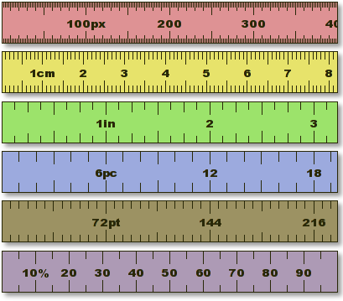
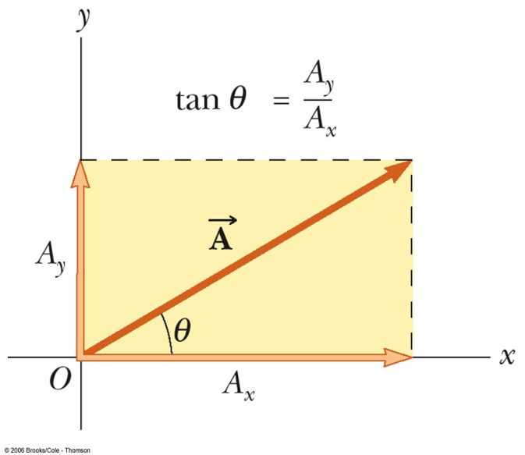
Introduction
Physics 101 – Course Information
Brief Introduction to Physics
Chapter 1 – Measurements
  Measuring things
  Three basic units: Length, Mass, Time
  SI units
  Unit conversion
  Dimension
Chapter 2 – Vectors
  Vectors and scalars
  Describe vectors geometrically
  Components of vectors
  Unit vectors
  Vectors addition and subtraction
January 22-25, 2013

Slide 3
Course Information: Instuctor
Instructor: Mr Dahiru Sanni
Office: Room 317 Block B
Office hours: 1-2pm & 5-6pm (Mons., Tues.)
Telephone: 08051182472
Email: dahiru.sanni@nileuniversity.edu.ng
January 22-25, 2013

Slide 4
Course Information: Materials
1st Section Mons. 1-2pm, 2nd Section Tues. 1-3pm
Primary Textbook: “Slides that will be provided for you” and University Physics by Sears and Zemansky (Pearson Education)
Lab Material: “Physics Laboratory Manual ”
January 22-25, 2013

Slide 5
Course Information: Grading
Homeworks (10% total)
    Homework 1: due on Friday, October 26, 2pm
    Homework 2: due on Friday, November 30, 2pm
    Homework 3: due on Friday, December 14, 2pm
    Homework will be given at least a week before the submission deadline
Final Exam (60%)
Attendance/Class activities (10%)
Midterm Test (15%)
Homework (15%)
Final Letter Grade
A 70-100
B 60-69
C 50-59
D 45-49
E 40-44
F 0-39
January 22-25, 2013

Slide 6
Physics and Mechanics
Physics deals with the nature and properties of matter and energy. Common language is mathematics. Physics is based on experimental observations and quantitative measurements.
The study of physics can be divided into six main areas:
  Classical mechanics – Physics I (Phys. 101)
  Electromagnetism – Physics II (Phys. 102)
  Optics – Physics III
  Relativity
  Thermodynamics –
  Quantum mechanics –
Classical mechanics deals with the motion and equilibrium of material bodies and the action of forces.
January 22-25, 2013

Slide 7




Classical Mechanics
Classical mechanics deals with the motion of objects
Classical Mechanics: Theory that predicts qualitatively & quantitatively the results of experiments for objects that are NOT
  Too small: atoms and subatomic particles – Quantum Mechanics
  Too fast: objects close to the speed of light – Special Relativity
  Too dense: black holes, the early Universe – General Relativity
Classical mechanics concerns the motion of objects that are large relative to atoms and move at speeds much slower than the speed of light (i.e. nearly everything!)
January 22-25, 2013

Slide 8

Chapter 1 Measurement
To be quantitative in Physics requires measurements
How tall is Ming Yao? How about
his weight?
  Height: 2.29 m (7 ft 6 in)
  Weight: 141 kg (310 lb)
Number + Unit
  “thickness is 10.” has no physical meaning
  Both numbers and units necessary for
  any meaningful physical quantities
January 22-25, 2013

Slide 9
Type of Quantities
Many things can be measured: distance, speed, energy, time, force ……
These are related to one another: speed = distance / time
List the three basic quantities (DIMENSIONS):
  LENGTH
  MASS
  TIME
Define other units in terms of these.
January 22-25, 2013

Slide 10
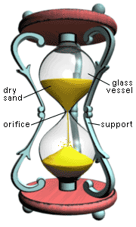
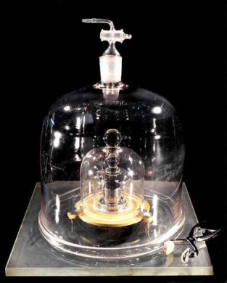
SI Unit for 3 Basic Quantities
Many possible choices for units of Length, Mass, Time (e.g. Yao is 2.29 m or 7 ft 6 in)
In 1960, standards bodies control and define Système Internationale (SI) unit as,
  LENGTH: Meter
  MASS: Kilogram
  TIME: Second
January 22-25, 2013

Slide 11
Fundamental Quantities and SI Units
Length | meter | m
Mass | kilogram | kg
Time | second | s
Electric Current | ampere | A
Thermodynamic Temperature | kelvin | K
Luminous Intensity | candela | cd
Amount of Substance | mole | mol
January 22-25, 2013

Slide 12

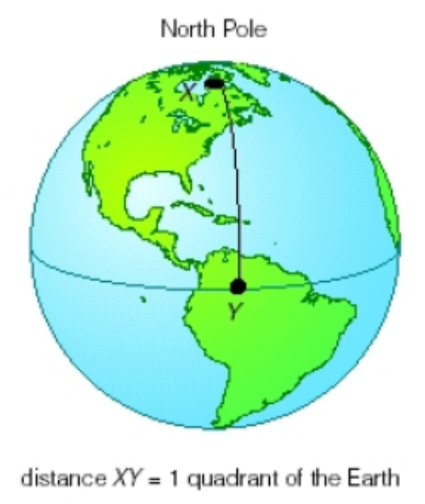
SI Length Unit: Meter
French Revolution Definition, 1792
1 Meter = XY/10,000,000
1 Meter = about 3.28 ft
1 km = 1000 m, 1 cm = 1/100 m, 1 mm = 1/1000 m
Current Definition of 1 Meter: the distance traveled by light in vacuum during a time of 1/299,792,458 second.
January 22-25, 2013

Slide 13


SI Time Unit: Second
1 Second is defined in terms of an “atomic clock”– time taken for 9,192,631,770 oscillations of the light emitted by a ¹³³Cs atom.
Defining units precisely is a science (important, for example, for GPS):
  This clock will neither gain nor lose a second in 20 million years.
January 22-25, 2013

Slide 14
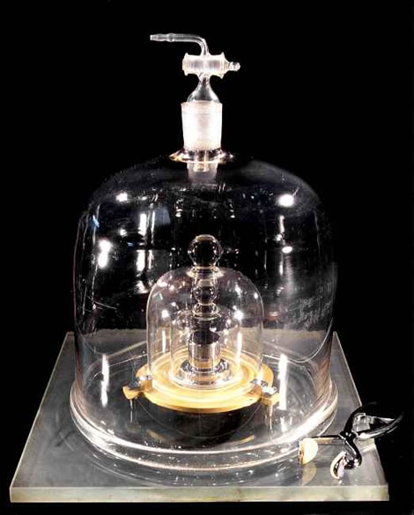
SI Mass Unit: Kilogram
1 Kilogram – the mass of a specific platinum-iridium alloy kept at International Bureau of Weights and Measures near Paris. (Seeking more accurate measure: http://www.economist.com/news/leaders/21569417-kilogram-it-seems-no-longer-kilogram-paris-worth-mass)
Copies are kept in many other countries.
Yao Ming is 141 kg, equivalent to weight of 141 pieces of the alloy cylinder.
January 22-25, 2013

Slide 15
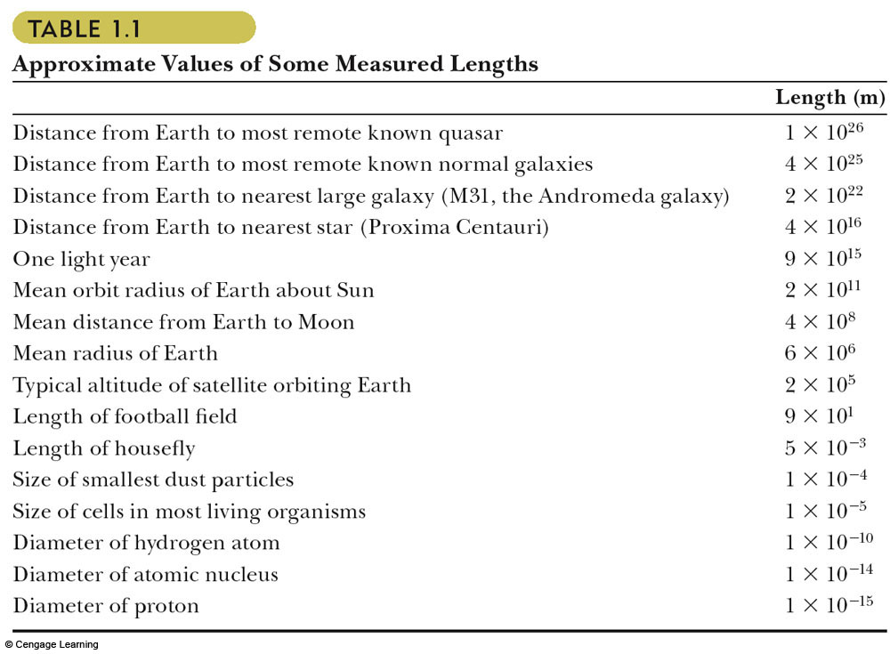
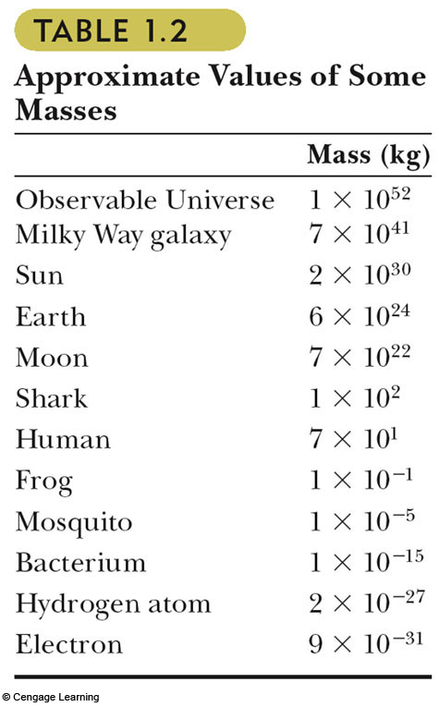
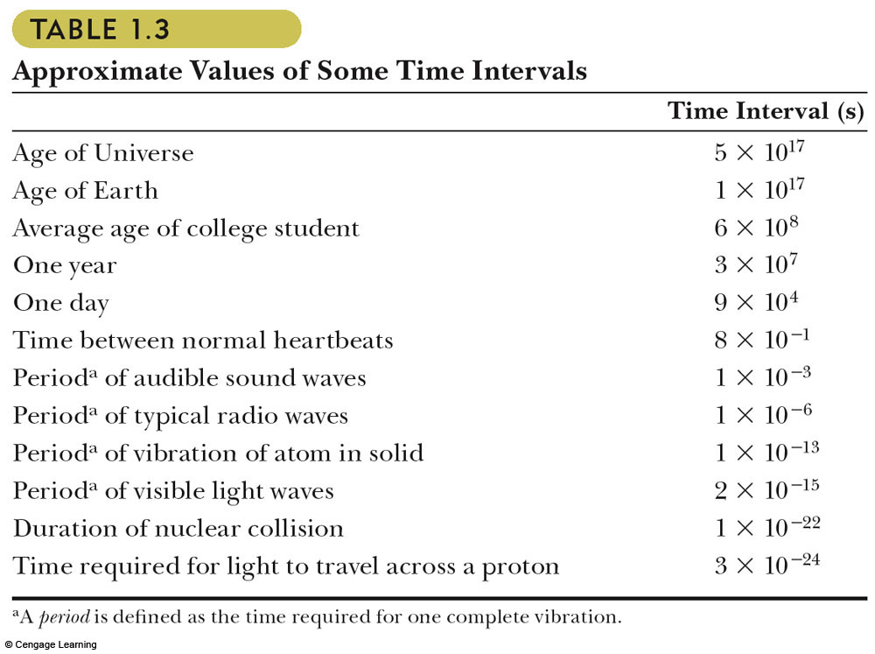
Length, Mass, Time
January 22-25, 2013

Slide 16
Prefixes for SI Units
3,000 m = 3  1,000 m
= 3  10³ m = 3 km
1,000,000,000 = 10⁹ = 1G
1,000,000 = 10⁶ = 1M
1,000 = 10³ = 1k
141 kg = ? g
1 GB = ? Byte = ? MB
10^{x} | Prefix | Symbol
x=18 | exa | E
15 | peta | P
12 | tera | T
9 | giga | G
6 | mega | M
3 | kilo | k
2 | hecto | h
1 | deca | da
If you are rusty with scientific notation,
see appendix B.1 of the text
January 22-25, 2013

Slide 17
Prefixes for SI Units
10^{x} | Prefix | Symbol
x=-1 | deci | d
-2 | centi | c
-3 | milli | m
-6 | micro | µ
-9 | nano | n
-12 | pico | p
-15 | femto | f
-18 | atto | a
0.003 s = 3  0.001 s
= 3  10⁻³ s = 3 ms
0.01 = 10⁻² = centi
0.001 = 10⁻³ = milli
0.000 001 = 10⁻⁶ = micro
0.000 000 001 = 10⁻⁹ = nano
0.000 000 000 001 = 10⁻¹²
= pico = p
1 nm = ? m = ? cm
3 cm = ? m = ? mm
January 22-25, 2013

Slide 18
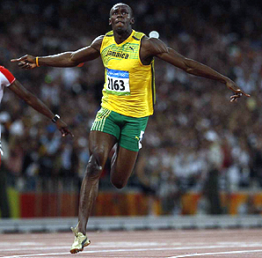
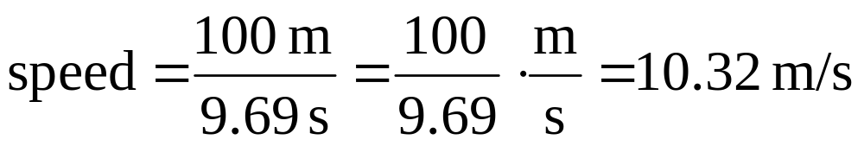
Derived Quantities and Units
Multiply and divide units just like numbers
Derived quantities: area, speed, volume, density ……
  Area = Length  Length SI unit for area = m²
  Volume = Length  Length  Length SI unit for volume = m³
  Speed = Length / time SI unit for speed = m/s
  Density = Mass / Volume SI unit for density = kg/m³
In 2008 Olympic Game, Usain Bolt sets world record at 9.69 s in Men’s 100 m Final. What is his average speed ?
January 22-25, 2013

Slide 19
Other Unit System
U.S. customary system: foot, slug, second
Cgs system: cm, gram, second
We will use SI units in this course, but it is useful to know conversions between systems.
  1 mile = 1609 m = 1.609 km 1 ft = 0.3048 m = 30.48 cm
  1 m = 39.37 in. = 3.281 ft 1 in. = 0.0254 m = 2.54 cm
  1 lb = 0.465 kg 1 oz = 28.35 g 1 slug = 14.59 kg
  1 day = 24 hours = 24 * 60 minutes = 24 * 60 * 60 seconds
January 22-25, 2013

Slide 20
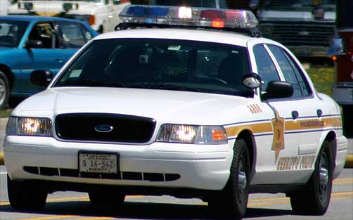
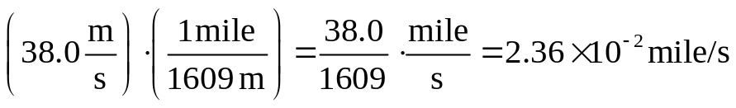
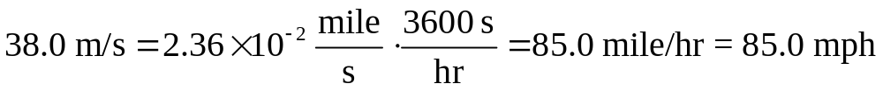
Unit Conversion
Example: Is he speeding ?
  On the garden state parkway of New Jersey, a car is traveling at a speed of 38.0 m/s. Is the driver exceeding the speed limit?
  Since the speed limit is in miles/hour (mph), we need to convert the units of m/s to mph. Take it in two steps.
  Step 1: Convert m to miles. Since 1 mile = 1609 m, we have two possible conversion factors, 1 mile/1609 m = 6.215x10⁻⁴ mile/m, or 1609 m/1 mile = 1609 m/mile. What are the units of these conversion factors?
  Since we want to convert m to mile, we want the m units to cancel => multiply by first factor:
  Step 2: Convert s to hours. Since 1 hr = 3600 s, again we could have 1 hr/3600 s = 2.778x10⁻⁴ hr/s, or 3600 s/hr.
  Since we want to convert s to hr, we want the s units to cancel =>

Slide 21
Dimensions, Units and Equations
Quantities have dimensions:
  Length – L, Mass – M, and Time - T
Quantities have units: Length – m, Mass – kg, Time – s
To refer to the dimension of a quantity, use square brackets, e.g. [F] means dimensions of force.
Quantity | Area | Volume | Speed | Acceleration
Dimension | [A] = L² | [V] = L³ | [v] = L/T | [a] = L/T²
SI Units | m² | m³ | m/s | m/s²
January 22-25, 2013

Slide 22
Dimensional Analysis
Necessary either to derive a math expression, or equation or to check its correctness.
Quantities can be added/subtracted only if they have the same dimensions.
The terms of both sides of an equation must have the same dimensions.
  a, b, and c have units of meters, s = a, what is [s] ?
  a, b, and c have units of meters, s = a + b, what is [s] ?
  a, b, and c have units of meters, s = (2a + b)b, what is [s] ?
  a, b, and c have units of meters, s = (a + b)³/c, what is [s] ?
  a, b, and c have units of meters, s = (3a + 4b)^{1/2}/9c², what is [s] ?
January 22-25, 2013

Slide 23
Summary
The three fundamental physical dimensions of mechanics are length, mass and time, which in the SI system have the units meter (m), kilogram (kg), and second (s), respectively
The method of dimensional analysis is very powerful in solving physics problems.
Units in physics equations must always be consistent. Converting units is a matter of multiplying the given quantity by a fraction, with one unit in the numerator and its equivalent in the other units in the denominator, arranged so the unwanted units in the given quantity are cancelled out in favor of the desired units.
January 22-25, 2013

Slide 24
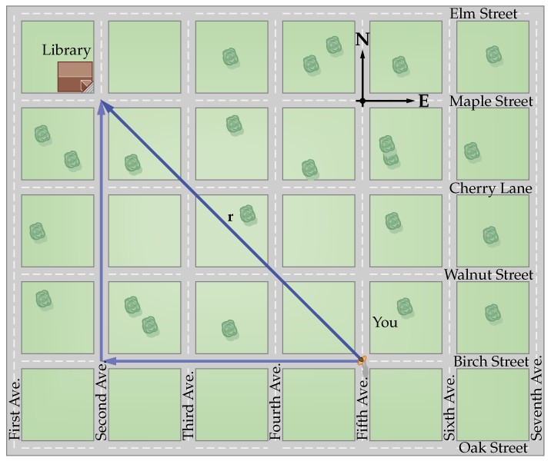
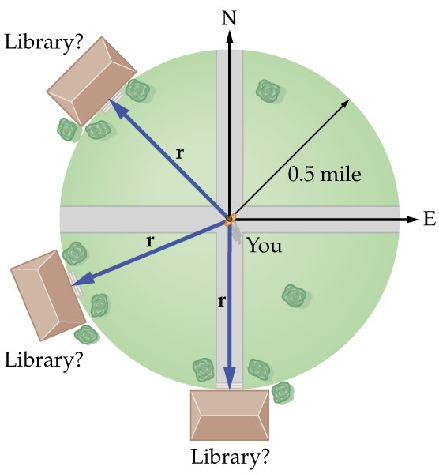
Vector vs. Scalar Review
A library is located 0.5 mi from you. Can you point where exactly it is?
You also need to know the direction in which you should walk to the library!
All physical quantities encountered in this text will be either a scalar or a vector
A vector quantity has both magnitude (value + unit) and direction
A scalar is completely specified by only a magnitude (value + unit)
January 22-25, 2013

Slide 25
Vector and Scalar Quantities
Vectors
  Displacement
  Velocity (magnitude and direction!)
  Acceleration
  Force
  Momentum
Scalars:
  Distance
  Speed (magnitude of velocity)
  Temperature
  Mass
  Energy
  Time
To describe a vector we need more information than to describe a scalar! Therefore vectors are more complex!
January 22-25, 2013

Slide 26

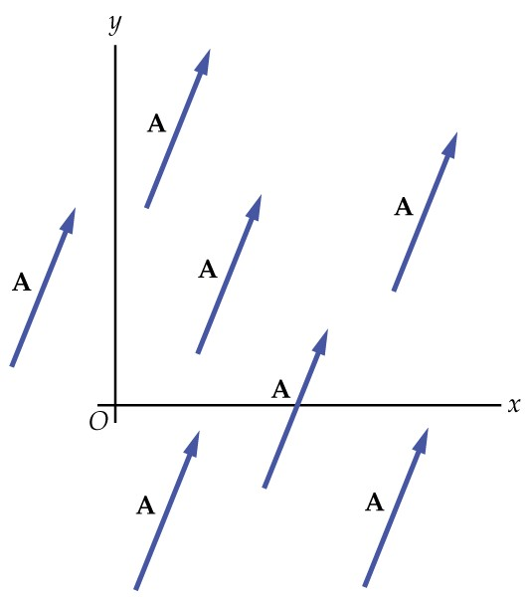

Important Notation
To describe vectors we will use:
  The bold font: Vector A is A
  Or an arrow above the vector:
  In the pictures, we will always show vectors as arrows
  Arrows point the direction
  To describe the magnitude of a vector we will use absolute value sign: or just A,
  Magnitude is always positive, the magnitude of a vector is equal to the length of a vector.
January 22-25, 2013

Slide 27
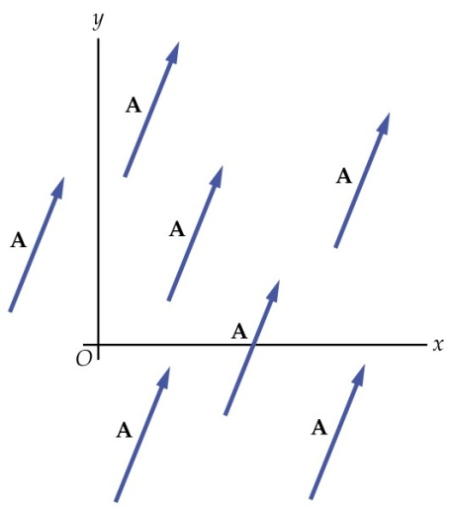

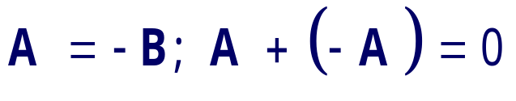

Properties of Vectors
Equality of Two Vectors
  Two vectors are equal if they have the same magnitude and the same direction
Movement of vectors in a diagram
  Any vector can be moved parallel to itself without being affected
Negative Vectors
  Two vectors are negative if they have the same magnitude but are 180° apart (opposite directions)
January 22-25, 2013

Slide 28
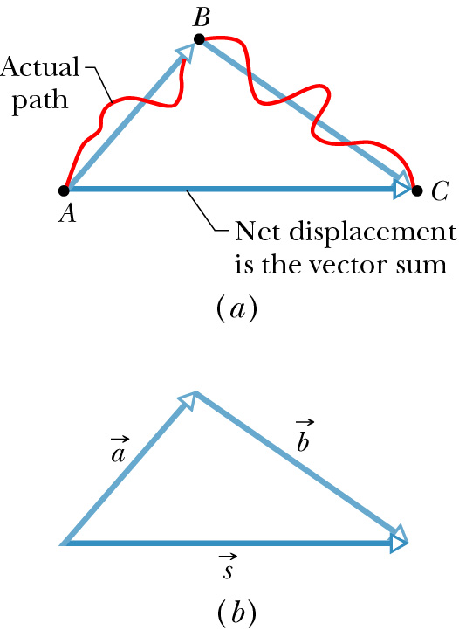
Adding Vectors
When adding vectors, their directions must be taken into account
Units must be the same
Geometric Methods
  Use scale drawings
Algebraic Methods
  More convenient
January 22-25, 2013

Slide 29



Adding Vectors Geometrically (Triangle Method)
Draw the first vector with the appropriate length and in the direction specified, with respect to a coordinate system
Draw the next vector with the appropriate length and in the direction specified, with respect to a coordinate system whose origin is the end of vector and parallel to the coordinate system used for : “tip-to-tail”.
The resultant is drawn from the origin of to the end of the last vector
January 22-25, 2013

Slide 30
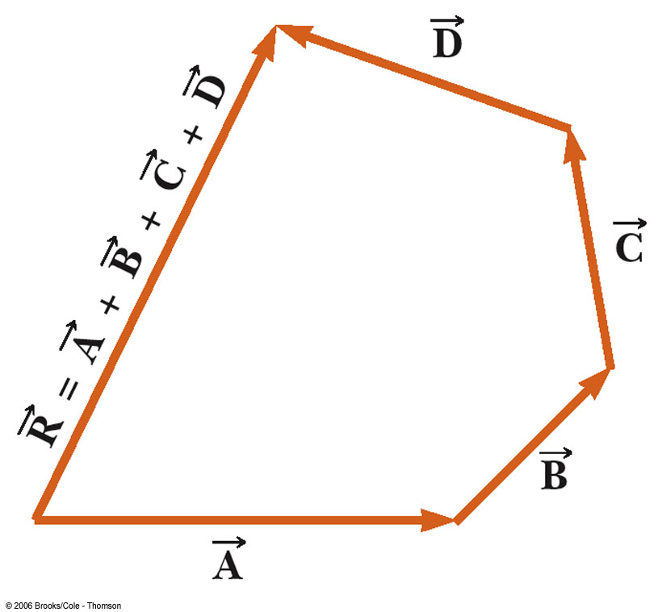



Adding Vectors Graphically
When you have many vectors, just keep repeating the process until all are included
The resultant is still drawn from the origin of the first vector to the end of the last vector
January 22-25, 2013

Slide 31
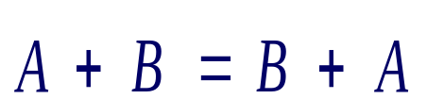
Adding Vectors Geometrically (Polygon Method)
Draw the first vector with the appropriate length and in the direction specified, with respect to a coordinate system
Draw the next vector with the appropriate length and in the direction specified, with respect to the same coordinate system
Draw a parallelogram
The resultant is drawn as a diagonal from the origin
January 22-25, 2013

Slide 32
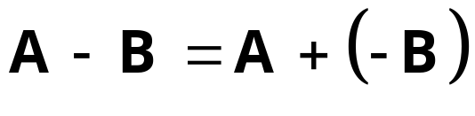


Vector Subtraction
Special case of vector addition
  Add the negative of the subtracted vector
Continue with standard vector addition procedure
January 22-25, 2013
Notes:
Now, let’s see vectors subtraction. We can consider it as a special case of vector addition. A-B=A+(-B), then continue with standard vector addition procedure: first, to sketch vector A with appropriate length and proper angle. Then, to sketch vector B with its tail starting from the head of A. If we draw from the tail of A to the tip of B, what is that? A+B. Now, we need A+(-B), what is –B? Rotate B with 180 degree, to draw from the tail of A to the tip of –B. That is what we try to find, A-B

Slide 33
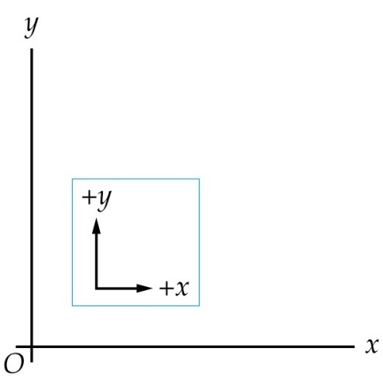
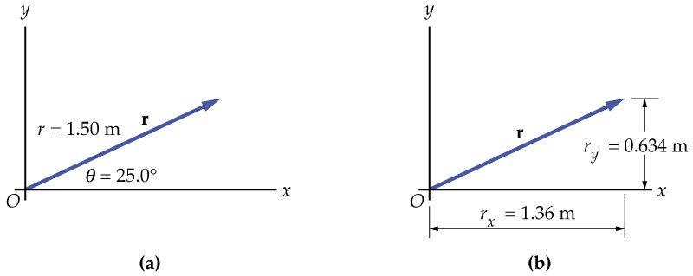
Describing Vectors Algebraically
Vectors: Described by the number, units and direction!
Vectors: Can be described by their magnitude and direction. For example: Your displacement is 1.5 m at an angle of 25⁰.
Can be described by components? For example: your displacement is 1.36 m in the positive x direction and 0.634 m in the positive y direction.
January 22-25, 2013

Slide 34
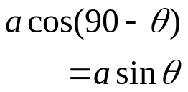

Components of a Vector
A component is a part
It is useful to use rectangular components These are the projections of the vector along the x- and y-axes
90−θ
θ
January 22-25, 2013

Slide 35
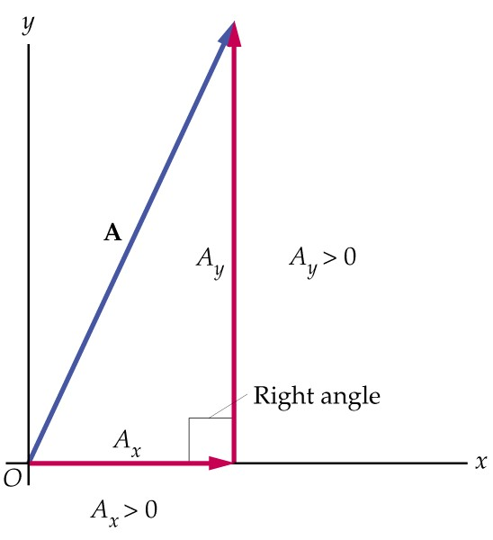
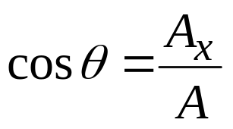

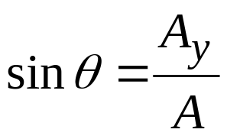
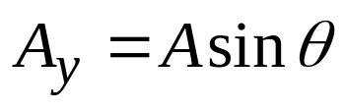
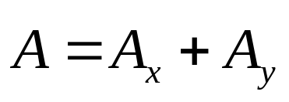
Components of a Vector
The x-component of a vector is the projection along the x-axis
The y-component of a vector is the projection along the y-axis
Then,
θ
January 22-25, 2013

Slide 36
Components of a Vector
The previous equations are valid only if θ is measured with respect to the x-axis
The components can be positive or negative and will have the same units as the original vector
θ=0, A_{x}=A>0, A_{y}=0
θ=45°, A_{x}=A cos 45°>0, A_{y}=A sin 45°>0
A_{x} < 0
A_{y} > 0
A_{x} > 0
A_{y} > 0
θ=90°, A_{x}=0, A_{y}=A>0
θ
θ=135°, A_{x}=A cos 135°<0, A_{y}=A sin 135°>0
A_{x} < 0
A_{y} < 0
A_{x} > 0
A_{y} < 0
θ=180°, A_{x}=−A<0, A_{y}=0
θ=225°, A_{x}=A cos 225°<0, A_{y}=A sin 225°<0
θ=270°, A_{x}=0, A_{y}=−A<0
θ=315°, A_{x}=A cos 315°<0, A_{y}=A sin 315°<0
January 22-25, 2013

Slide 37
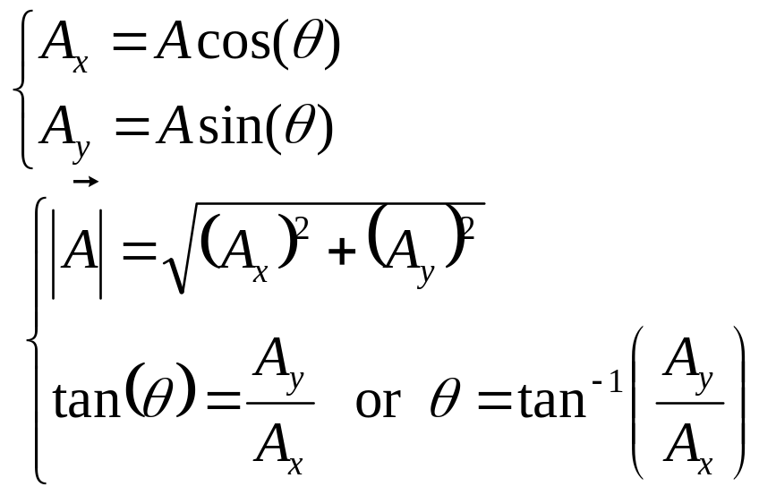
More About Components
The components are the legs of the right triangle whose hypotenuse is A
θ
Or,
January 22-25, 2013

Slide 38



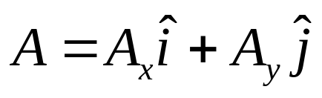
Unit Vectors
Components of a vector are vectors
Unit vectors i-hat, j-hat, k-hat
Unit vectors used to specify direction
Unit vectors have a magnitude of 1
Then
θ
y
j
i
x
k
Magnitude + Sign
Unit vector
z
January 22-25, 2013

Slide 39
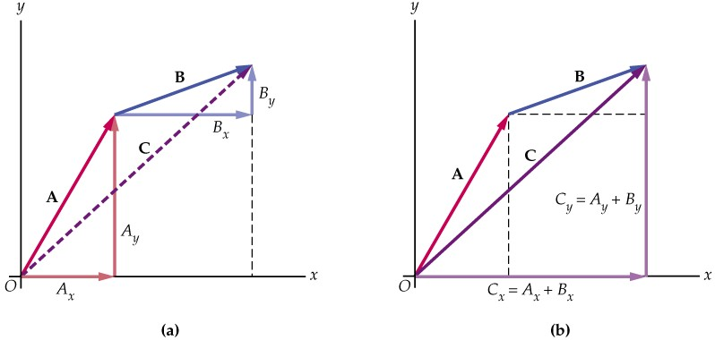
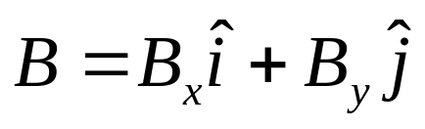
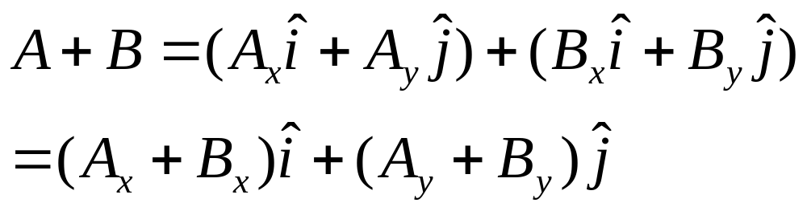
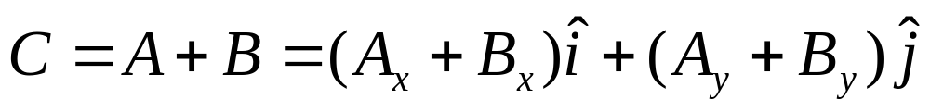
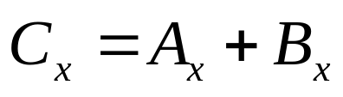
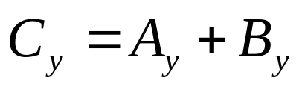
Adding Vectors Algebraically
Consider two vectors
Then
If
so
January 22-25, 2013

Slide 40
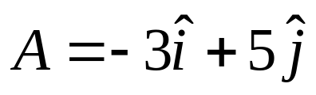
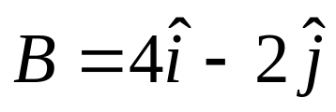
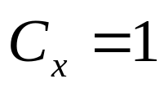
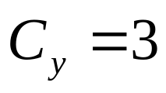
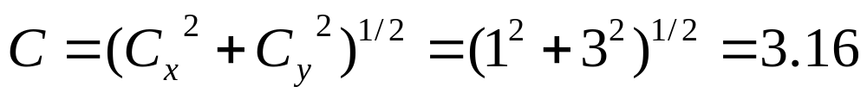
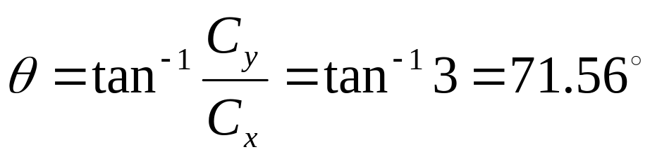
Example : Operations with Vectors
Vector A is described algebraically as (-3, 5), while vector B is (4, -2). Find the value of magnitude and direction of the sum (C) of the vectors A and B.
January 22-25, 2013

Slide 41
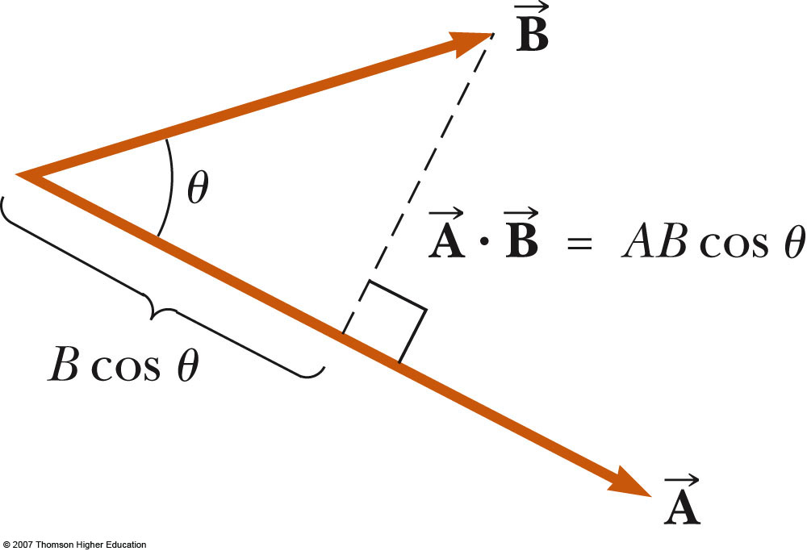

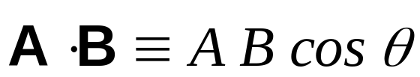
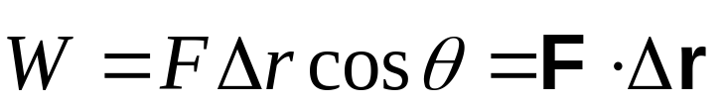
Scalar Product of Two Vectors
The scalar product of two vectors is written as
  It is also called the dot product
  θ is the angle between A and B
Applied to work, this means
February 18, 2011

Slide 42

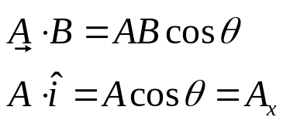




Dot Product
The dot product says something about how parallel two vectors are.
The dot product (scalar product) of two vectors can be thought of as the projection of one onto the direction of the other.
Components
θ
February 18, 2011

Slide 43
Projection of a Vector: Dot Product
The dot product says something about how parallel two vectors are.
The dot product (scalar product) of two vectors can be thought of as the projection of one onto the direction of the other.
Components
Projection is zero
π/2
February 18, 2011

Slide 44
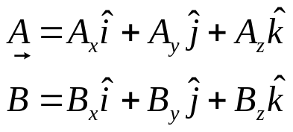



Derivation
How do we show that ?
Start with
Then
But
So
February 18, 2011

Slide 45





Cross Product
The cross product of two vectors says something about how perpendicular they are.
Magnitude:
  θ is smaller angle between the vectors
  Cross product of any parallel vectors = zero
  Cross product is maximum for perpendicular vectors
  Cross products of Cartesian unit vectors:
θ
y
j
i
x
k
z
i
j
k
February 18, 2011

Slide 46





Cross Product
Direction: C perpendicular to both A and B (right-hand rule)
  Place A and B tail to tail
  Right hand, not left hand
  Four fingers are pointed along the first vector A
  “sweep” from first vector A into second vector B through the smaller angle between them
  Your outstretched thumb points the direction of C
First practice
February 18, 2011

Slide 47



More about Cross Product
The quantity ABsinθ is the area of the parallelogram formed by A and B
The direction of C is perpendicular to the plane formed by A and B
Cross product is not commutative
The distributive law
The derivative of cross product
obeys the chain rule
Calculate cross product
February 18, 2011

Slide 48


Derivation
How do we show that ?
Start with
Then
But
So
February 18, 2011

Slide 49




Vector Products of Unit Vectors
Contrast with scalar products of unit vectors
Signs are interchangeable in cross products

Slide 50

Vector Products Using Determinants
The cross product can be expressed as
Expanding the determinants gives

Slide 51



Example 11.1
Given
Find
Result is

Slide 52


Example 11.2: Torque Vector
Given the force F and position r:
Find the torque τ produced
Result is

Slide 53



Summary
Polar coordinates of vector A (A, θ)
Cartesian coordinates (A_{x}, A_{y})
Relations between them:
  Beware of tan 180-degree ambiguity
Unit vectors:
Addition of vectors:
Scalar multiplication of a vector:
Multiplication of two vectors? It is possible, and we will introduce it later as it comes up.

Slide 54
Exercise
Calculate |a × b| when |a| = 2, |b| = 4 and the angle between a and b is 45 degrees
Calculate |a × b| when |a| = 3, |b| = 5 and the angle between a and b is 60
Calculate |a × b| when |a| = 1, |b| = 3 and the angle between a and b is 30
January 22-25, 2013

Slide 55
Calculate the magnitude of the torque = s × F when |s| = 2m, |F| = 4N and angle =30
Exercise 6. Calculate the magnitude of the velocity v = w ×s when
|w| = 3s^1 , |s| = 2m and angle = 45
Exercise 7. If a = 4i+2j−k and b = 2i−6i−3k then calculate a vector that is perpendicular to both a and b
January 22-25, 2013

Slide 56
Exercise 8. Calculate the vector a × b when a = 2i + j − k and
b = 3i − 6j + 2k
l
January 22-25, 2013

